Slide 1
Portfolio Construction Framework -Factor Overview
Factor Groups Overview | Intuition in One Sentence
Value (“cheapness”) | Companies priced low relative to fundamentals may offer higher long-term returns as prices revert to intrinsic value.
Quality (“profitability”) | Firms generating consistent profitability often sustain competitive advantages and compound value over time.
Financial Strength (“resilience”) | Companies with strong balance sheets and low leverage can better withstand economic downturns.
Momentum (‘trend”) | Stocks that have performed well recently tend to continue outperforming as positive trends persist.
Volatility / Risk (“stability”) | Lower-volatility stocks can provide smoother, risk-efficient returns over long horizons.
Liquidity (“tradeable”) | More liquid stocks reduce trading costs and support scalable portfolio construction.

Slide 2
Factor Build Components – 11 Features
Factor Component Overviews
VALUE (“cheapness”) Earnings Yield Higher earnings relative to price signal a cheaper, potentially undervalued stock. Book/Price Low price vs. book value points to assets selling at a discount. Sales/Price High sales relative to price indicate inexpensive revenue exposure. | QUALITY (“profitability”) ROE High ROE reflects efficient use of shareholder capital. ROA High ROA signals strong operational efficiency. Gross Profitability Strong gross profits suggest durable competitive advantages.
FINANCIAL STRENGTH (“resilience”) Leverage (Debt/Assets) Lower leverage reduces financial distress risk. Cash Flow to Debt Stronger cash flow improves debt-servicing capacity. | MOMENTUM (‘trend”) 12-Month Price Momentum Recent winners often continue trending upward.
VOLATILITY / RISK(“stability”) 60-Day Volatility Lower short-term volatility reflects more stable stock behavior. | LIQUIDITY (“tradeable”) 3-Month Average Daily Dollar Volume Higher liquidity lowers trading costs and improves scalability.

Slide 3
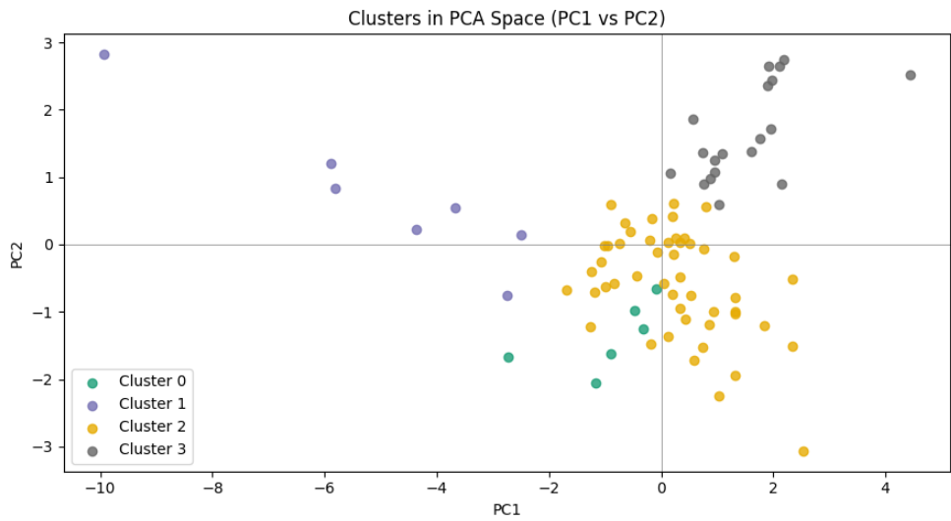
Principal Component 1 (PC1): Quality + Financial Strength + Risk composite axis
PC1 explains ~37.5% of total variance
(…But PC1 is not a pure “value” axis…)
PC1 ≈ “Quality / Stability / Balance-Sheet Strength”
This explains why PCA plot shows strong left–right separation
Together PC1 & PC2 explain 52.5% of the total variance
Strong positive loadings
ADDV (0.54) → liquidity / size
Debt-to-Assets (0.48) → leverage; FS
PC2 High
large
liquid
leveraged
PC1 High
high-quality
profitable
financially strong
Strong positive loadings
ROA (0.44); QUAL
ROE (0.36);QUAL
Earnings Yield (0.39); VAL
Cash / Debt (0.36); FS
Momentum (0.26)
Strong negative loadings
Volatility (−0.34)
Book-to-Market (−0.35);
VAL
PC1 Low
riskier
lower-quality
volatile
PC2 Low
cash-rich
operationally efficient
Principal component 2 (PC2): Capital-Structure + Liquidity axis.
PC2 explains ~14.6% of total variance
PC2 ≈ “Size / Leverage / Capital Structure”
This is why clusters separate vertically in PC space.
Strong negative loadings
Cash / Debt (−0.34); FS
Sales-to-Price (−0.29); VAL
Gross Profitability (−0.27); QUAL

Slide 4
Cluster Regimes Overview
Cluster 0: Deep Value / Cyclical Repricing
This group consists of stocks trading at substantial discounts to book value and sales. While momentum is modestly positive, profitability metrics are weak. These names typically represent cyclicals or turnaround candidates where returns depend on mean reversion rather than operational excellence.
Cluster 1: Distressed / High Risk
This cluster captures financially fragile companies with elevated volatility, poor profitability, weak balance sheets, and negative momentum. These stocks exhibit classic value-trap characteristics, where cheapness is not compensated by quality or stability.
Cluster 2: Balanced Quality / Defensive Core
Stocks in this cluster show strong profitability, conservative leverage, and steady momentum. Risk levels are moderate and liquidity is sufficient. This group represents a defensively positioned quality core suitable for capital preservation and stable compounding.
Cluster 3: High-Quality / Mega-Cap Compounders
This cluster contains the most liquid and operationally efficient firms. High ROE, ROA, and gross profitability combine with low volatility and exceptional tradability. Although valuation metrics are elevated, these companies dominate through durability and scale.

Slide 5
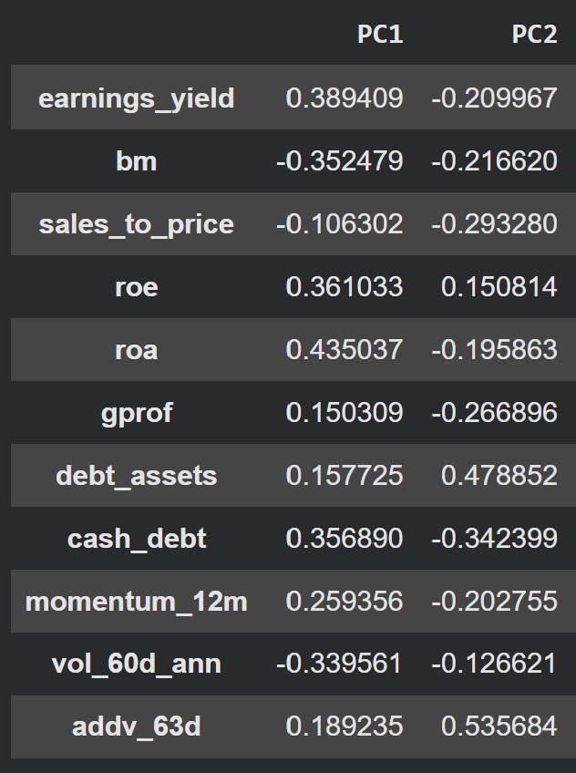
PC1 — Quality + Profitability vs Risk
(Primary market regime axis)
Strong positive loadings
ROA (0.44)
ROE (0.36)
Earnings Yield (0.39)
Cash / Debt (0.36)
Momentum (0.26)
Strong negative loadings
Volatility (−0.34)
Book-to-Market (−0.35)
Economic interpretation
PC1 cleanly separates:
High-quality, profitable, financially strong stocks
vs
Riskier, lower-quality, volatile names
This is not a pure “value” axis — it’s closer to:
Quality + Financial Strength + Risk composite
PC1 ≈ “Quality / Stability / Balance-Sheet Strength”
This explains why your PCA plot shows strong left–right separation.
PC2 — Balance Sheet & Size / Leverage Axis
(Secondary structural axis)
Strong positive loadings
ADDV (0.54) → liquidity / size
Debt-to-Assets (0.48) → leverage
Strong negative loadings
Cash / Debt (−0.34)
Sales-to-Price (−0.29)
Gross Profitability (−0.27)
Economic interpretation
PC2 contrasts:
Large, liquid, leveraged firms
vs
Cash-rich, operationally efficient firms
This is a capital-structure + liquidity axis.
PC2 ≈ “Size / Leverage / Capital Structure”
This is why clusters separate vertically in PC space.

Slide 6
Value Factor (“Cheapness”) - Isolated PC Analysis
PC1 captures a refined Value dimension that rewards earnings-based cheapness while penalizing balance-sheet and revenue-only value, effectively separating profitable value from value traps.
PC2 represents a pure valuation axis, capturing broad cheapness versus expensiveness across earnings, book, and sales measures without distinguishing value quality.
Value Feature PC1 Loading
Earnings Yield +0.389
Book / Price (bm) −0.352
Sales / Price −0.106
Value Feature PC2 Loading
Earnings Yield −0.210
Book / Price (bm) −0.217
Sales / Price −0.293
PC1 distinguishes “cheap stocks with real earnings” from stocks that look cheap only because:
Assets are impaired
Sales are low margin
Earnings power is weak
PC2 measures how expensive or cheap a stock is overall, regardless of why. It captures:
Market-wide valuation compression/expansion
Style rotation between Value ↔ Growth
Cross-sectional cheapness
This is the axis most sensitive to: Rates, Risk appetite and Macro regime shifts
High PC1 stocks:
Cheap on earnings
Less dependent on asset backing
More likely to be operationally viable
Lower probability of being value traps
Low PC1 stocks:
Cheap on book or sales
Weak earnings conversion
Higher distress or cyclicality
High PC1 stocks:
Cheap on all valuation metrics
Strong Value tilt
Likely outperform in value-led regimes
Low PC1 stocks:
Cheap on book or sales
Weak earnings conversion
Higher distress or cyclicality
PC1 = “Quality-Adjusted Value”
PC2 = “Absolute Valuation Level”

Slide 7
Quality Factor (“Profitability”) - Isolated PC Analysis
PC1 strongly captures quality through operational and capital efficiency, with ROA and ROE as dominant drivers, signaling durable, high-quality profitability rather than leverage-driven returns.
PC2 differentiates quality by its source, separating leverage-enhanced ROE from profitability driven by operational efficiency and gross margins.
Quality Feature PC1 Loading
ROE +0.361
ROA +0.435
Gross Profitability +0.150
Quality Feature PC2 Loading
ROE +0.151
ROA −0.196
Gross Profitability −0.267
PC1 defines quality primarily through operating efficiency, not accounting leverage:
Assets → Earnings conversion matters more than equity leverage
Profitability quality > financial engineering
PC2 splits the Quality factor internally:
PC2 is not a “more vs less quality” axis.
Instead, PC2 is a composition axis: How profitability is generated — not how strong it is overall.
High PC1 stocks:
Efficient asset utilization
Strong capital returns
Real operating profits (not just revenue scale)
Low PC1 stocks:
Weak margins
Capital inefficiency
Fragile profitability
High PC1 stocks (Financially engineered profitability):
ROE is being boosted by leverage or capital structure
Profitability per dollar of assets is weaker
Gross margins are not the core strength
Low PC1 (Operational profitability):
• Profits driven by operations, margins, and efficiency
• Less reliance on leverage
• More durable business economics
PC1: = “Operational Profitability / Capital Efficiency”
PC2 = “Operational Quality vs Leverage-Driven Returns”

Slide 8
Financial Strength Factor (“Resilience”) - Isolated PC Analysis
PC1 rewards firms with strong cash-flow-driven debt-servicing capacity, emphasizing balance-sheet resilience over simple leverage minimization.
PC2 isolates financial fragility, penalizing firms with high leverage unsupported by cash flow and highlighting balance-sheet stress risk.
Financial Strength PC1 Loading
Debt/Assets +0.158
Cash Flow to Debt +0.357
Financial Strength PC2 Loading
Debt/Assets +0.479
Cash Flow to Debt -0.342
PC1 Rewards firms that:
That generate strong internal cash flows
That can service obligations comfortably
With balance sheets that are functional, not necessarily conservative
Resilience comes from cash generation, not from zero leverage
PC2 separates:
Healthy leverage (PC1-positive) from fragile leverage (PC2-positive)
It is effectively measuring leverage without coverage (which is why the signs flip relative to PC1)
It’s one of the strongest predictors of distress in finance
High PC1 firms:
May use debt
But comfortably service it
Are resilient in stress scenarios
Low PC1 firms:
Weak cash flows
Poor debt coverage
Vulnerable to tightening financial conditions
Positive PC2 (↑ PC2)
High leverage
Weak debt-service capacity
Reliance on balance-sheet expansion rather than internal cash flow
Negative PC2 (↓ PC2)
Lower leverage
Strong cash flow coverage
Balance-sheet conservatism
PC1: = “Cash-Flow-Driven Financial Strength”
PC2 = “Leverage-Induced Financial Risk”

Slide 9
Momentum Factor (“Trend”) - Isolated PC Analysis
PC1 embeds momentum as a reinforcing trend signal, rewarding stocks with sustained 12-month price strength aligned with fundamental quality and resilience.
PC2 loads negatively on momentum, favoring stocks that have not yet exhibited price trends and may represent early-stage or contrarian opportunities before market recognition.
Momentun Feature PC1 Loading
12-mo Px Momentum +0.259
Momentun Feature PC2 Loading
12-mo Px Momentum -0.203
PC1 rewards stocks that are already working; momentum here is acting as:
A confirmation signal, not a standalone trend factor
Reinforcement of quality, profitability, and resilience
PC2 is not a trend-following axis. It moves against momentum, favoring stocks that:
Have not recently performed well
May be early-cycle, mean-reverting, or fundamentally improving
Often look “unloved” by the market
PC1 increases when:
12-month price momentum is positive
Recent price winners are present
PC1 decreases when:
Momentum is weak or negative
Stocks are recent losers
PC2 increases when:
12-month momentum is weak or negative
Stocks are recent underperformers or laggards
PC2 decreases when:
12-month momentum is strong
Stocks are recent winners
PC2 explicitly penalizes momentum.
PC1: = “Structural Momentum”
PC2 = “Leverage-Induced Financial Risk”

Slide 10
Volatility Factor (“Trend”) - Isolated PC Analysis
PC1 strongly rewards low short-term volatility, indicating that stability and risk control are core components of the dominant economic dimension in the dataset.
PC2 slightly favors lower-volatility stocks, but volatility plays a supporting rather than defining role in this dimension.
Volatility Feature PC1 Loading
60-day Volatility -0.34
Volatility Feature PC2 Loading
60-day Volatility -0.13
PC1 treats volatility as a risk penalty, not a source of return
This aligns with:
Conservative factor construction
Long-horizon, fundamental alpha
Drawdown-aware portfolio design
PC2 still prefers stability, but:
Volatility is not the dominant driver
It acts as a supporting constraint, not a defining feature
PC2 mildly penalizes volatile stocks, but volatility is not what PC2 is “about.”
Stocks scoring high on PC1 tend to be:
Operationally profitable
Financially resilient
Low volatility
Institutionally investable
Stocks scoring low on PC1 tend to be:
Noisier
Riskier
More speculative
Less predictable in short-term behavior
Stocks scoring high on PC2 tend to be:
More liquid
Larger / more tradable
Moderately leveraged
Not excessively volatile
Stocks scoring low on PC2 tend to be:
Less liquid
More financially stressed
Slightly more volatile
PC1: = “Stability / Quality Risk Control”
PC2 = “Risk Guardrail”

Slide 11
Liquidity Factor (“Trend”) - Isolated PC Analysis
PC1 rewards liquidity as part of a broader preference for high-quality, stable, and scalable stocks.
PC2 is fundamentally a liquidity and scalability axis, separating institutionally tradable stocks from capacity-constrained names.
Liquidity Feature PC1 Loading
3-month ADDV +0.189
Liquidity Feature PC2 Loading
3-month ADDV +0.536
PC1 is fundamentally a “Quality + Stability + Scale” axis, and liquidity fits naturally into that story:
Large, liquid stocks
Easier to trade at scale
Lower implementation costs
Lower market impact
PC2 is best interpreted as a Liquidity / Scale axis. It separates highly tradable, institution-scale stocks from smaller, harder-to-trade names. This axis captures:
Market depth
Trading capacity
Execution efficiency
Scalability of strategies
High PC1 stocks:
High ADDV (very liquid)
Easy to trade in size
Lower transaction costs
Typically larger, more established firms
Low PC1 stocks:
Thinly traded
Higher bid–ask spreads
Capacity-constrained
Harder to scale systematically
High PC2 stocks:
Very high ADDV
Large-cap / mega-cap profiles
Tight bid–ask spreads
Ideal for scalable portfolios
Low PC2 stocks:
Thinly traded
Small- or micro-cap
Higher market impact
Limited institutional capacity
PC1: = “High-quality, stable, scalable”
PC2 = “How scalable — regardless of quality”

